Slide 1
JSM 2014, Boston, August 5, 2014 Session 285 8:30 AM - 10:20 AM
Communicating Statistical Findings to Consulting Clients Operating in a Decision-Making Climate:
Best and Worst Practices

Slide 2
Panelists & Organizer/Chair
Panelists:
Michael Greene, Deloitte Consulting
John H. Schuenemeyer, Southwest Statistical
Consulting
Ralph M. Turner, HealthCore
MaryJo O. Smith, Ypsilon Associates
Organizer/Chair:
Isabella R. Ghement

Slide 3
Acknowledgements
We would like to acknowledge the valuable contribution
of our colleagues in shaping up this session:
Dr. Elena Rantou
Dr. David Bristol
Dr. David McArthur
Dr. Richard Layton

Slide 4
Session Structure
General comments on decision-making
Decision-making, risk and uncertainty
Roles of consultants in decision-making
Consulting workflow
Floor Discussion

Slide 5
Session Goals
We hope this session will help you to:
Understand what decision-making entails
Become aware of the interplay of risk and uncertainty in decision-making
Clarify your role and responsibilities in the decision-making process
Strengthen your decision-making abilities

Slide 6
Decisions and Decision-Making
Decision:
A choice made between 2 or more available
alternatives
Notes:
Source: http://managementinnovations.wordpress.com/2008/12/08/types-of-decisions-decision-making-process/

Slide 7
Decisions and Decision-Making
Decision-Making Process:
1. Identify an existing problem
2. List possible alternatives for solving the problem
3. Select the most beneficial of these alternatives
4. Implement the selected alternative
5. Monitor if the implemented alternative is solving
the identified problem
6. Adapt the implemented alternative as appropriate
Statistical consultants can facilitate most of these steps
Notes:
Source: http://managementinnovations.wordpress.com/2008/12/08/types-of-decisions-decision-making-process/

Slide 8
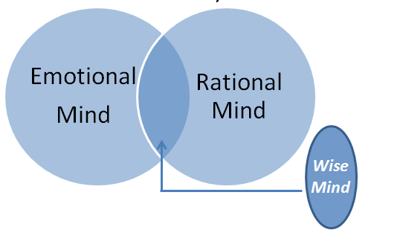
General Comments on Decision-Making
Typically, decisions are made using the emotional mind first and then, the rational mind
The best decisions should use the wise mind (blend of the emotional and rational minds)
Wise
Mind

Slide 9
General Comments on Decision-Making
The wise mind can be engaged in decision making by asking questions such as:
What kind of decisions can be made in this context?
What information is needed to make the decision?
What are the pros and cons of each decision?
Will this decision lead to a good outcome or a bad outcome?

Slide 10
Decision-Making: General Comments
We make decisions based on available information
Unknown factors can influence the outcome of our
decisions
Contingency planning helps us deal with the
unknowable

Slide 11
Decision-Making: General Comments
Decisions can lead to either good or bad outcomes
We can only find out if we made a good decision in
hindsight
However, we can consider “what if” scenarios to predict
whether or not a decision has the potential to be
good/bad.

Slide 12
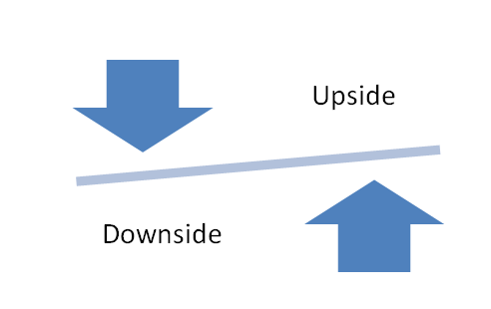
Decision-Making: General Comments
Every decision has an upside and a downside
A good decision-maker must weight these effectively

Slide 13
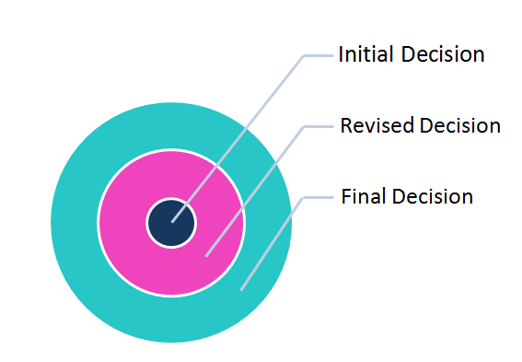
General Comments on Decision-Making
Decisions can and should be made adaptively and in
small increments

Slide 14
General Comments on Decision-Making
Real-world decisions are subject to constraints (e.g., time,
human resources, knowledge, expertise)
Decisions which factor in these constraints are “realistic”
Decisions which ignore these constraints are “idealistic”
and likely doomed to failure

Slide 15
General Comments on Decision-Making
Most of the decisions we make are not life or death
But… all decisions have consequences
When consequences concern others, we need to pay extra
attention to our decision-making

Slide 16
General Comments on Decision-Making
Dealing with “decision paralysis”
“Is there a small decision I could make now? If yes,
what information do I need to make this decision?”
Important to break “big decisions” down into a series of
manageable “smaller decisions”
Starting small is key.

Slide 17
General Comments on Decision-Making
Collaborative decisions are usually better than one-sided decisions. In collaboration,
1 + 1 often equals more than 2!
Decisions that are mindful of all the stakeholders’ requirements are better than those decisions that aim to impose change from the outside or from above
Relationship building is an important part of any decision-making process

Slide 18
Relationship Building
Treat every client as your most important one
Respond promptly
Ask questions / Encourage feedback
Go the extra mile
Focus on results
Always summarize next steps

Slide 19
Key Things to Remember
Timeliness
Information
Contingency planning
What-if scenarios
Wise mind
Relationship building

Slide 20
Decision-Making, Risk and Uncertainty
Decisions often require consideration of
risk and uncertainty
Personal Decisions:
climb a mountain
decide to quit smoking
have surgery
Business Decisions:
introduce a new product line
drill a well to explore for oil
start a new business

Slide 21
Decision-Making, Risk and Uncertainty
Risk involves loss – dollars, health, job, ….
Uncertainty involves the unknowable <- enter the
consulting
statistician
A lower level of uncertainty generally helps to
reduce the risk

Slide 22
Decision-Making, Risk and Uncertainty
Let L be the loss (usually converted to a $ amount) and
p be the probability of loss
Then the risk is given by Risk = L
and the expected loss is given by:
E_{L} = R_{p} = p x L
Often alternative expected losses E_{L} are considered
p is where the uncertainty arises

Slide 23
Decision Making, Risk and Uncertainty
As consulting statisticians, we need to:
Recognize the importance that risk plays in decision making
Develop a model/analysis that correctly represents uncertainty
Explain the uncertainty in context, often with the use of graphs

Slide 24
Decision Making, Risk and Uncertainty
Uncertainty can be minimized by accounting for the
following factors during modeling/analyses:
Dependence (e.g., temporal, spatial)
Measurement error in input variables
Interactions among variables
Relevance of historical data
Relevant theory
Uncertainty needs to reflect random variations

Slide 25
Decision Making, Risk and Uncertainty
Explaining Uncertainty to Clients:
Appropriate graphics can be more meaningful to a
client to understand uncertainty than numerical
values
As consultants, we need to emphasize that, in
many situations, numerical values should serve only
as guidelines

Slide 26
Decision Making, Risk and Uncertainty
Boxplots

Slide 27
Decision Making, Risk and Uncertainty
Problem:
An energy company desires to find oil by drilling a well in a given location. The cost of drilling is $10M; the loss if the hole is dry.
Decision to be made:
Drill or not to drill
A consideration:
Better alternative uses of $10M

Slide 28
Decision Making, Risk and Uncertainty
Data:
Seismic, geochemical, test well, etc.
Analysis (statisticians role):
Estimate the oil potential of this tract of land and uncertainty using available information

Slide 29
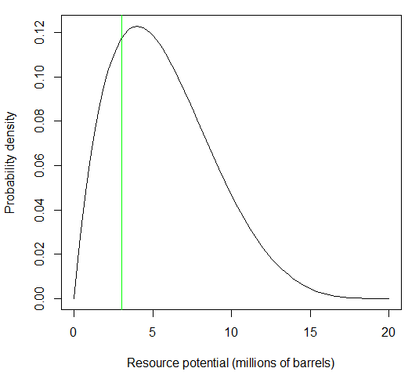
Result – oil potential in millions of barrels
Decision Making, Risk and Uncertainty
Profit
Loss

Slide 30
Decision Making, Risk and Uncertainty
Probability of loss:
Prob potential resources < 3 million barrels = 0.22
Expected loss E_{l} = $10 M x 0.22 = $ 2.2M
Actual loss if resource < 3 million barrels = $10M
Assumes uncertainty estimate is correct

Slide 31
The W.L Gore Decision Rule
After study, a team of staff members would come to Bill Gore, the founder of W.L. Gore & Associates and asks permission to begin product development work on a new line of jackets
He would ask the team leader two questions:
1. If all goes according to plan, can the company
make a decent return on our investment?
2. If all goes to hell in a handbag, can the company
survive?
He required a YES to both questions
Notes:
Bill not risk averse

Slide 32
Role of Consultants in Decision-Making
Concept | Suggestions
Know the audience | Use executive summaries Don’t “bury the lead”
Provide all the information | Provide all the facts Give advice, but do not present as a fact
Communicate clearly | Do not use jargon Introduce and define ideas Annotate – you will not always be there
Over-communicate | Status updates Less formal may be better

Slide 33
Roles Across the Research Process
Study Questions
Consultants can and should assist with decision-making at all stages.
Key considerations:
Decision-makers (stakeholders)?
Audience for analysis?
Communication frequency?
Project planning?
Background
Study Design
Analytical Strategy
Results
Discussion
Conclusion
Diagram Source:
Dr. David McArthur
Client (s) will be expected to make important decisions at the end of a study.

Slide 34
Consulting in the Real-World
The information we receive from clients/collaborators is always incomplete
Despite this, we have to move forward with incomplete information
The real world is messy, and people change their minds, and we still have to get things done on time
The only way to get things done on time is to always anticipate and plan for changes in the information content and quality

Slide 35
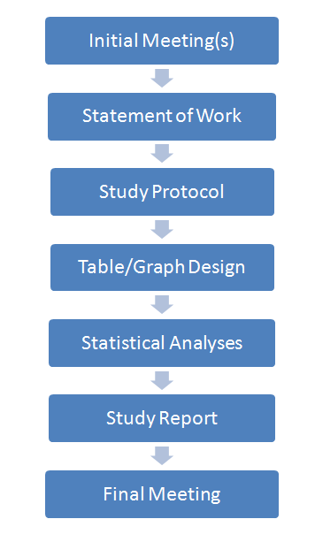
Think About Consulting Work Flow

Slide 36
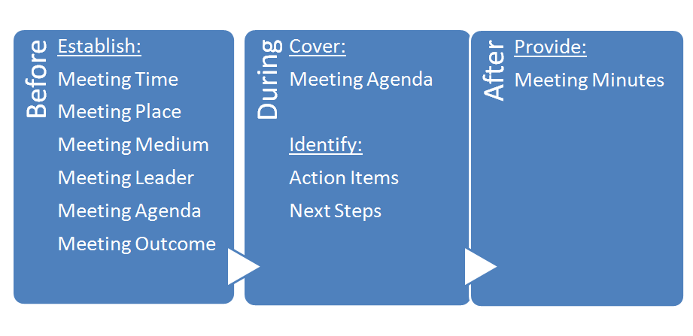
Meetings

Slide 37
Statement of Work
An SOW provides an overview and some descriptive detail about the work to be completed.
It provides the client with an explicit expectation of the methods to be used, deliverables, costs, and payment schedule.
The SOW is developed collaboratively by the consultant and the client.
… See SOW Template …

Slide 38
Study Protocol
The study protocol provides a road map for successful
completion of a consulting project.
Ideally, the study protocol should be prepared at the
study design phase based on client input.
However, it is good practice to write the study protocol
even if the analyses have been completed and the data
are ready.
… See Study Protocol Template…

Slide 39
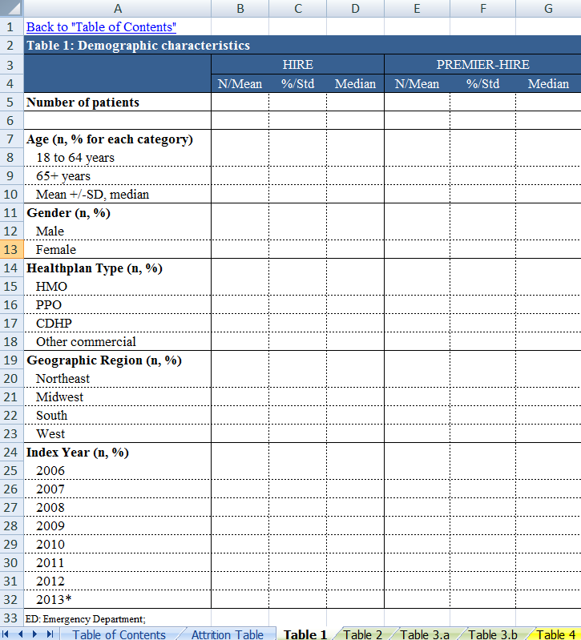
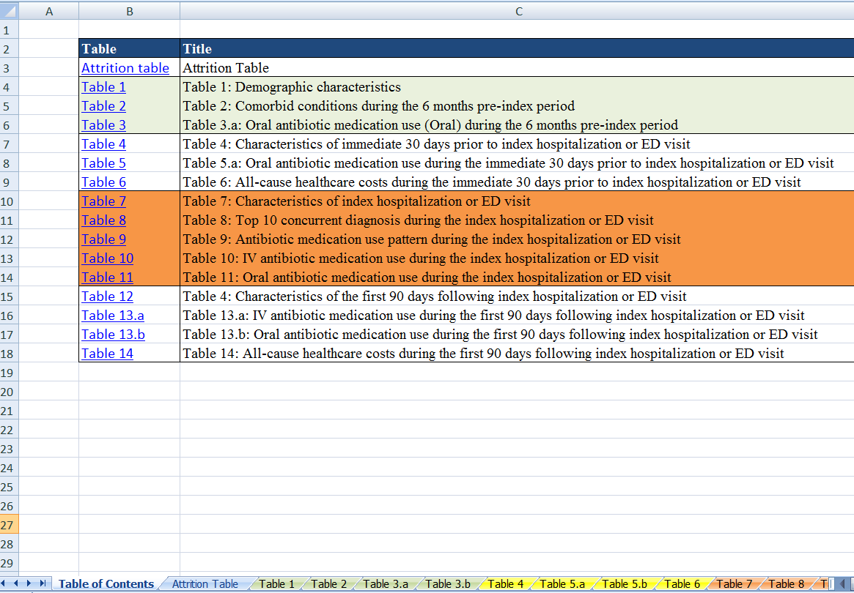
Table Shells
Use client input to design table shells at the time when
the study protocol is created.
For easy navigation, store table shells in an Excel spreadsheet
which includes a Table of Contents.

Slide 40
Statistical Analyses
The consultant will take the lead in determining the statistical analyses to be used.
However, it is the consultant’s responsibility to explain their rationale for the statistical strategies in a manner the client can understand.
Some clients do have statistical knowledge, and where possible, it is good form to make this a collaborative effort.

Slide 41
Study Report
Study report should (ideally) be prepared once all
statistical analyses are finalized, presented to the client,
and approved by client.
Study report should be based on a Study Report
Template, appropriately modified to reflect the context
and requirements of the current project.
… See Study Report Template …

Slide 42
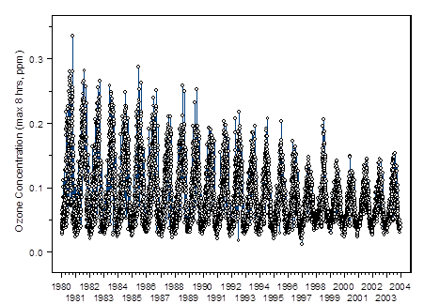
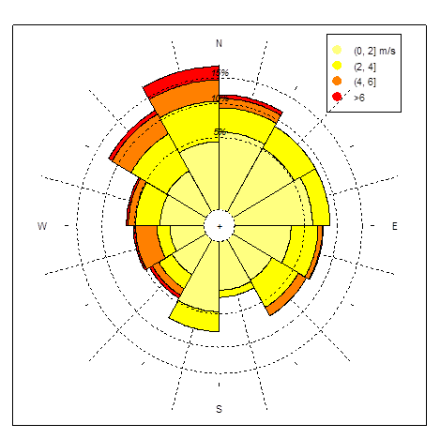
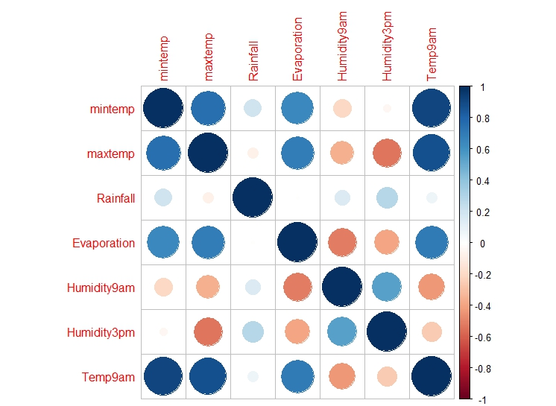
Statistical Graphs
Ozone trend
Wind rose – Mesa Verde National Park
Correlation plot for the weather data

Slide 43
Statistical Graphs
Statistical graphs can help clients to:
Better understand their own problem
Become familiar with the study data
Comprehend the study findings/implications
Make informed decisions
Graphs should have a clear, self-contained message.

Slide 44
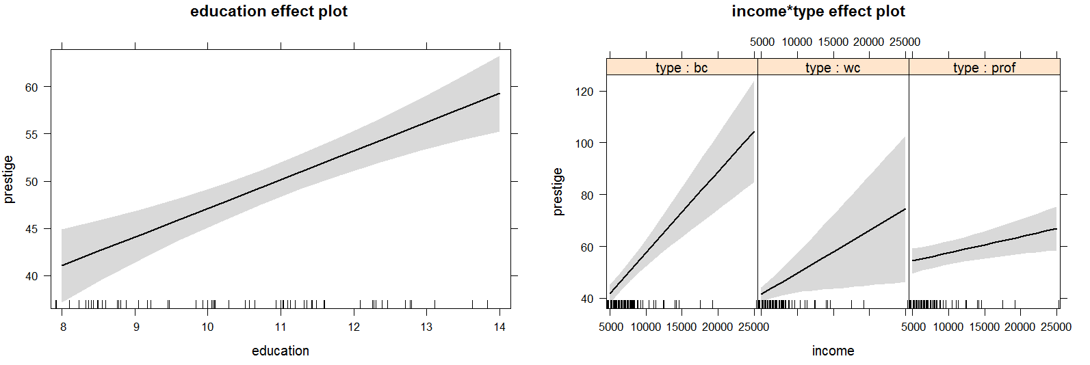
Example of Graphs with a Message
Model: prestige ~ education + income*type
Education is fixed at its average level
With education fixed at its average level, we can see how income and occupation type combine to affect occupation prestige
Income seems more important for blue collar (bc) occupations and less important for professional (prof) occupations
Source: Dr. John Fox, UseR! 2014

Slide 45
Example of Graphs with a Message
When we add partial residuals to the effect plots, we can also see that
we are estimating the effect of blue collar occupations less precisely because we don’t have any high income data for these occupations
Source: Dr. John Fox, UseR! 2014

Slide 46
A Tale of Two Graphs…
Unlabeled Graph
Annotated Graph
An increase in predictor is associated with an increase in outcome correlation: 0.68
Potential outlier?
Label axes and add titles as necessary
Add key messages to the graphics – you might not always be there to explain the graphics
When using colors, shapes, or other aspects, keep presentation media in mind (e.g., project versus paper, grayscale versus color)

Slide 47
Summary
As consultants, we should strive to:
Make sure that we provide our clients with adequate and timely information
Translate this information into a language the clients can easily understand
Structure and present this information in a way that supports decision-making

Slide 48
Contact Information
Panelist | E-mail
Michael Greene, Deloitte Consulting | mfgreene79@yahoo.com
John H. Schuenemeyer, Southwest Statistical Consulting | jackswsc@q.com
Ralph M. Turner, HealthCore | RTurner@healthcore.com
MaryJo O. Smith, Ypsilon Associates | drmaryjosmith@gmail.com
Chair/Organizer | E-mail
Isabella R. Ghement, Ghement Statistical Consulting Company Ltd. | isabella@ghement.ca

Slide 49
Resources
Resources for this session area available on the
website:
http://www.ghement.ca/jsm2014.html.
Resources include:
Session slides
Handouts
Templates
References

Slide 50
Thank You
Thank you for attending our session.
We are looking forward to hearing from you with
questions, comments and suggestions.

